Slide 1

Dynamic Programming
CLRS Chapter 15.1, 15.2, 15.3

Slide 2

Introduction to Dynamic Programming?
A “smarter” way of doing divide and conquer:
Divide the problem into subproblems
Show that if you solve the subproblems optimally and combine them in the right way, you get an optimal solution
Work your way up through the subproblems
If subproblems overlap, don’t solve the same subproblem twice.

Slide 3
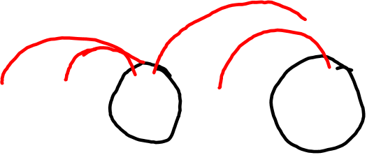
Simple Example: Fibonacci Series
1 1 2 3 5 8 13 21 34 …
F(1) = F(2) = 1; F(k) = F(k-1) + F(k-2) if k>2
Fib(i)
if i=1 or i=2 then return 1
Else return Fib(i-1)+Fib(i-2)

Slide 4
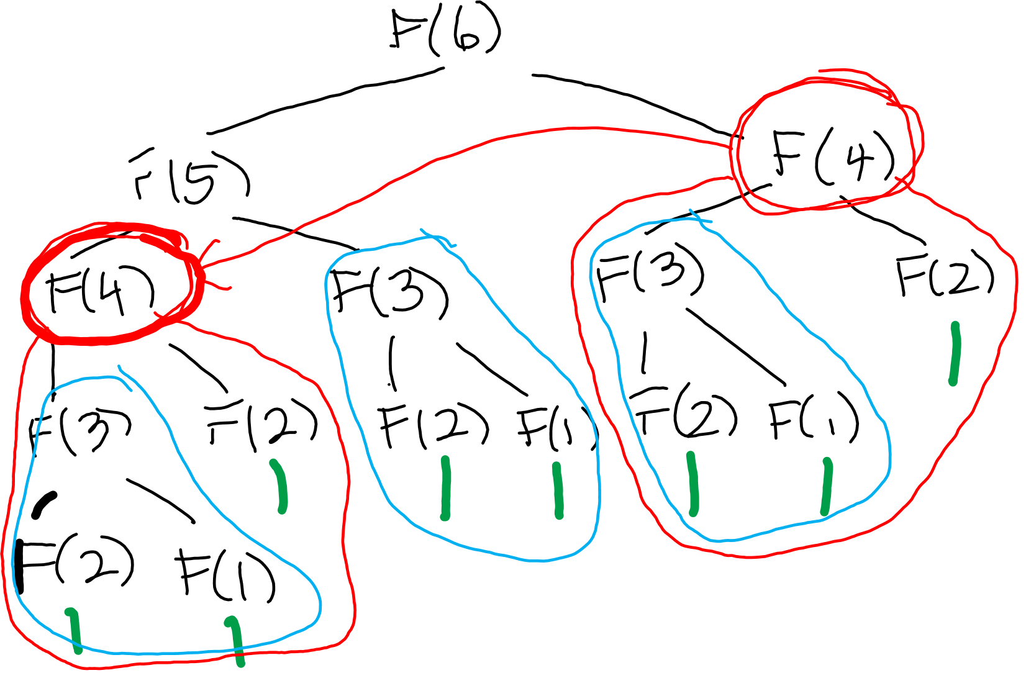

Slide 5
Improve Efficiency – identify overlapping subproblems
A “smarter” way of doing divide and conquer:
Once you solve a subproblem, write it down
If you need it again, just look it up– much more efficient
Called memoization, or top-down dynamic programming
The word programming has nothing to do with coding

Slide 6
